Slide 1
Pharmaceutical Microbiology
PHAR443B

Slide 2
Introduction to Pharmaceutical microbiology
Despite continuing poverty in many parts of the world and the devastating effects of infectious disease, the health of the world’s population is progressively improving.
This is reflected in the increase in life expectancy for the great majority of the countries over the last 40 years according to WHO.
In Central America, for example, the life expectancy has increased from 55 years in 1960 to 71 years in 2000.

Slide 3
Introduction to Pharmaceutical microbiology
The development of the many vaccines and other anti-infectives are:
Crucial to the improvement in world heath
Large investment in research by the major international pharmaceutical companies.

Slide 4
Introduction to Pharmaceutical microbiology
Disinfection and the properties of chemicals (biocides) used as antiseptics, disinfectants and preservatives are subjects of which pharmacists and other persons responsible for the manufacture of medicines should have a knowledge.
They are not the only antimicrobial substances that are relevant to medicine & Pharmacists; antibiotics are of major importance and represent a product category that regularly features among the top five most frequently prescribed.

Slide 5
Introduction to Pharmaceutical microbiology
The term ‘antibiotic’ is used in several different ways:
Originally an antibiotic was defined as a naturally occurring substance that was produced by one microorganism that inhibited the growth of, or killed, other microorganisms, i.e. an antibiotic was a natural product, a microbial metabolite.
Recently the term has come to encompass certain synthetic agents that are usually used systemically (throughout the body) to treat infection.

Slide 6
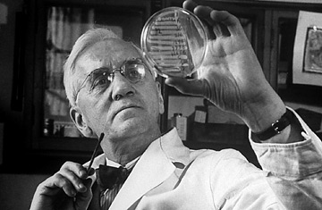
Introduction to Pharmaceutical microbiology
The 1st Antibiotic discovered was penicillin from Penicillium fungi, Penicillin was discovered accidentally by the scottish scientist and Nobel laureate Alexander fleming in 1928.
His discovery would change the course of history.
Commercial antibiotic production began with the manufacture of penicillin in the 1940s.

Slide 7
Introduction to Pharmaceutical microbiology
Microorganisms differ enormously in terms of their shape, size and appearance and in their genetic and metabolic characteristics.
All these properties are used in classifying microorganisms into the major groups with which many people are familiar, e.g. bacteria, fungi, protozoa and viruses.

Slide 8
Introduction to Pharmaceutical microbiology
1) virus
2) Viroid
3) Prions
4) Prokaryote
Bacteria
Archaea
5) Eukaryote
Fungi
Yeast
Mould
Protozoa
Algae

Slide 9
Viruse
Viruses
Viruses do not have a cellular structure.
Viruses are particles composed of nucleic acid (DNA, RNA) surrounded by protein.
Viruses contain nor recognizable chromosomes, cytoplasm and cell membranes.
Viruses are incapable of independent replication as they do not contain the enzymes necessary to copy their own nucleic acids; as a consequence, all viruses are intracellular parasites and are reproduced using the metabolic capabilities of the host cell.

Slide 10
Pharmaceutical importance of Virus
The importance of viruses to Pharmacy derives exclusively from their pathogenic potential.
Because of their lack of intrinsic metabolism, viruses are not susceptible to antibiotics, and the number of effective synthetic antiviral drugs is limited. Partly for these reasons, viral infections are among the most serious and difficult to cure.
Viruses are incapable of growing on manufactured medicines or raw materials, so they do not cause product spoilage.
Viruses are relatively easy to destroy by heat, radiation or toxic chemicals, so they do not represent a problem from this perspective.

Slide 12
Viroids
Viroids
Viroids(virusoids) are even simpler than viruses, being infectious particles comprising single stranded RNA without any associated protein.

Slide 13
Prions
Prions
Prions are unique as infectious agents in that they contain no nucleic acid.
A prion is an atypical form of a mammalian protein that can interact with a normal protein molecule and cause it to undergo a conformational change so that it, in turn, becomes a prion and ceases its normal function.
Prions are the agents responsible for bovine spongiform encephalopathy (BSE) (Mad-cow disease).

Slide 14
Prokaryotes and eukaryotes
Prokaryotes and eukaryotes
Microorganisms having a cellular structure are classified into two groups — the prokaryotes (bacteria and archaea) and eukaryotes (fungi, protozoa and algae).
The crucial difference between these two types of cell is the possession by the eukaryotes of a true cell nucleus in which the chromosomes are separated from the cytoplasm by a nuclear membrane.

Slide 15
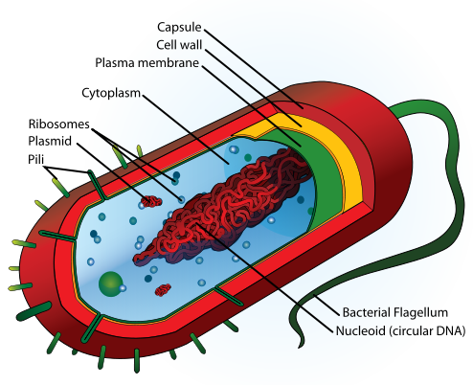
Prokaryotes and eukaryotes
The prokaryotes have no true nucleus
The prokaryotes normally possess just a single chromosome that is not separated from the other cell contents by a membrane.

Slide 16
Prokaryotes and eukaryotes
Prokaryotes are normally haploid (possess only one copy of the set of genes in the cell) and reproduce asexually.
Eukaroyotes are usually diploid (possess two copies of their genes) and normally have the potential to reproduce sexually.
The capacity for sexual reproduction confers the major advantage of creating new combinations of genes, which increases the scope for selection and evolutionary development.

Slide 17
Prokaryotes and eukaryotes
The restriction to an asexual mode of reproduction means that the organism in question is heavily reliant on mutation as a means of creating genetic variety and new strains with advantageous characteristics.

Slide 18
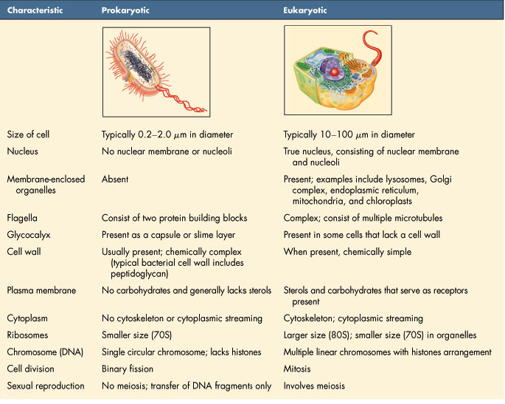
Prokaryotes and eukaryotes
Porkaryotes Vs Eukaryotes

Slide 19
Prokaryotes Bacteria
The bacteria of interest in pharmacy and medicine belong to the group known as the eubacteria.
The eubacteria are typically rod-shaped (bacillus), spherical (cocci), curved or spiral cells of approximately 0.5–5.0 μm (longest dimension)
The eubacteria are divided into two groups designated Gram-positive and Gram-negative according to their reaction to a staining procedure developed in 1884 by Christian Gram.

Slide 20
Pharmaceutical importance of Bacteria
The Pharmaceutical importance of Bacteria derives from the fact that many of the important bacteria are pathogens.
Some of these pathogens are of longstanding notoriety as a result of their ability to resist the activity of antibiotics and biocides (disinfectants, antiseptics and preservatives).
The majority of the other categories of clinically important antibiotics are produced by species of bacteria, notably streptomycetes.
Variety of bacteria are exploited commercially in the manufacture of other medicines including steroids, enzymes and carbohydrates.

Slide 21
Prokaryotes Archaea
The other subdivision of prokaryotes, the archaea, have little or no pharmaceutical importance
Archaea are largely comprise organisms capable of living in extreme environments (e.g. high temperatures, extreme salinity or pH).

Slide 22
Eukaryotes Fungi
Fungi
Fungi are eukaryotes
Fungi are structurally more complex and varied in appearance.
The term fungus covers both yeasts and moulds.

Slide 23
Eukaryotes Fungi ---- Yeast
Yeasts
Yeasts are normally unicellular organisms that are larger than bacteria (typically 5–10 mm)
Yeasts divide either by a process of binary fission or budding (whereby a daughter cell arises as a swelling or protrusion from the parent that eventually separates to lead an independent existence

Slide 24
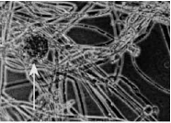
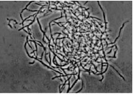
Eukaryotes Fungi ---- Mould
Mould
Mould is an imprecise term used to describe fungi that do not form fruiting bodies visible to the naked eye & are composed of filaments which en masse appear fuzzy or powdery.
Most moulds consist of a tangled mass (mycelium) of filaments or threads (hyphae) which vary between 1 and > 50 mm wide

Slide 25
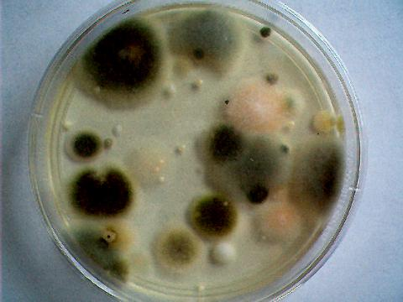
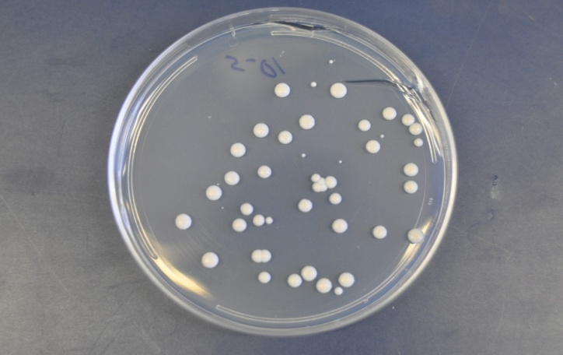
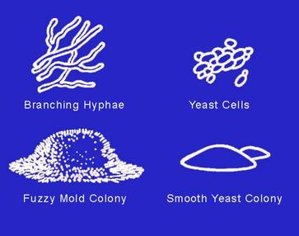
Mold colonies
fuzzy and fluffy or powdery in appearance.
tend to spread outward and across larger areas.
impart a "moldy" odor to their substrates.
Yeast colonies
more contact and round and dome-shaped.
grow to a certain size and stop and limited in their diameter.
impart a sweet odor to the air as they ferment sugars.
Yeasts are common fermenters of sugars and are valuable for baking.

Slide 26
Pharmaceutical importance of Fungi
Most fungi are saprophytes with relatively few having pathogenic potential
Fungi ability to form spores that are resistant to drying makes them important as contaminants of pharmaceutical raw materials, particularly materials of vegetable origin.
However, the degree of resistance presented by the spores is usually less than that exhibited by bacteria, and fungi do not represent a sterilization problem.
Fungi are capable of initiating an infection in persons with; impaired immune function
the term opportunist pathogens is used to describe microorganisms (of all types) possessing this characteristic. (AIDS, Cancer, Radiotherapy, Chemotherapy)

Slide 27
Biology of selected microorganisms (Bacteria)
Size and shape
Cellular components

Slide 28
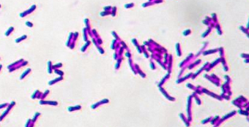
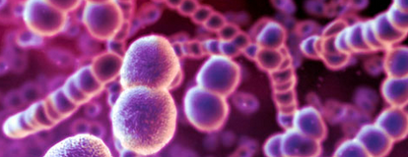
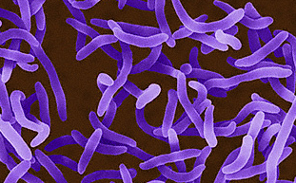
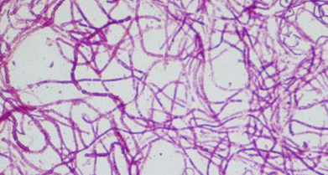
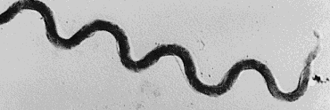
Biology of selected microorganisms (Bacteria)
1. Size and shape
Bacteria are the smallest free living organisms, their size being measured in micrometres (microns).
The majority of bacteria are 1–5 µm long and 1–2µm in diameter.
The majority of bacteria are unicellular and possess simple shapes, e.g.
round (cocci)
cylindrical (rod)
curved rods (vibrios)
longer rigid curved organisms with multiple spirals (spirochaetes)
Actinomycetes : rigid bacteria resembling fungi ( lengthy branched filaments)
Mycoplasmas highly pleomorphic (lack a conventional peptidoglycan (murein) cell wall)

Slide 29
Biology of selected microorganisms (Bacteria)
2. Cellular components
Bacteria possess a fairly simple base cell structure, comprising cell wall, cytoplasmic membrane, nucleoid, ribosomes.

Slide 30
Cellular components
It is very important for several reasons to have a good knowledge of these structures and their functions.
From a pharmaceutical and health-care perspective, it is important to be able to know how to kill bacterial contaminants and disease-causing organisms.
The essence of antimicrobial chemotherapy is selective toxicity.
This is achieved by exploiting differences between the structure and metabolism of bacteria and host cells.

Slide 31
Cellular components
Cell wall
The bacterial cell wall is an extremely important structure, being essential for the maintenance of the shape and integrity of the bacterial cell.
It is chemically unlike any structure present in eukaryotic cells and is therefore an obvious target for antibiotics that can attack and kill bacteria without harm to the host.
The primary function of the cell wall is to provide a strong, rigid structural component that can withstand the osmotic pressures caused by high chemical concentrations of inorganic ions in the cell.

Slide 32
Cellular components
Cell wall
Most bacterial cell walls have in common a unique structural component called peptidoglycan.
Peptidoglycan is a large macromolecule containing glycan (polysaccharide) chains that are cross-linked by short peptide bridges.
The glycan chain acts as a backbone to peptidoglycan, and is composed of alternating residues of N-acetyl muramic acid (NAM) and N-acetyl glucosamine (NAG).

Slide 33
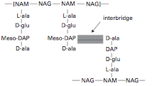
Cellular components
Cell wall
To each molecule of NAM is attached a tetrapeptide consisting of the amino acids L-alanine, D-alanine, D-glutamic acid and either lysine or diaminopimelic acid (DAP).

Slide 34
Cellular components
Cell wall
This glycan tetrapeptide repeat unit is crosslinked to adjacent glycan chains, either through a direct peptide linkage or a peptide interbridge.

Slide 35
Gram +ve Vs Gram -ve
Bacteria can be divided into two large groups, Gram-positive and Gram-negative, on the basis of a differential staining technique called the Gram stain.
Essentially, the Gram stain consists of treating a film of bacteria on a microscope slide with a solution of crystal violet, followed by a solution of iodine; these are then washed with an alcohol solution.
Gram-negative organisms the cells lose the crystal violet–iodine complex and are rendered colourless.
Gram-positive cells retain the dye.

Slide 36
Gram +ve Vs Gram -ve
Both cell types are counter-stained with a different coloured dye, e.g. carbol fuchsin, which is red. Hence, under the light microscope Gram-negative cells appear red while Gram-positive cells are purple.

Slide 37
Gram +ve Vs Gram -ve
The Gram-positive cell wall consists primarily of a single type of molecule whereas the Gram-negative cell wall is a multilayered structure and quite complex.

Slide 38
Gram +ve Bacteria
The cell walls of Gram-positive bacteria are quite thick (20–80 nm).
It consists of between 60% and 80% peptidoglycan, which is extensively crosslinked in three dimensions to form a thick polymeric mesh.
Gram-positive walls frequently contain acidic polysaccharides called teichoic acids.
Due to their –ve charge teichoic acids are partially responsible for the negative charge of the cell surface as a whole.
In some Gram-positive bacteria glycerol–teichoic acids are bound to membrane lipids and are termed lipoteichoic acids.

Slide 39
Gram +ve Bacteria

Slide 40
Gram –ve bacteria
The envelope of Gram- negative cells is a far more complicated structure than Gram +ve cells.
Although they contain less peptidoglycan (10–20% of wall), a second membrane structure is found outside the peptidoglycan layer.
This outer membrane is composed of proteins, lipoproteins, phospholipids and a component unique to Gram-negative bacteria, lipopolysaccharide (LPS).

Slide 41
Gram –ve bacteria
The outer membrane is attached to the peptidoglycan by a lipoprotein, one end of which is covalently attached to peptidoglycan and the other end is embedded in the outer membrane.
The outer membrane is not a phospholipid bilayer although it does contain phospholipids in the inner leaf, and its outer layer is composed of LPS, a polysaccharide–lipid molecule.

Slide 42
Gram –ve bacteria

Slide 43
LPS
The LPS is an important molecule because it determines the antigenicity of the Gram- negative cell and it is extremely toxic to animal cells.
The molecule consists of three regions, namely lipid A, core polysaccharide and O-specific polysaccharide.

Slide 44
LPS

Slide 45
LPS
The lipid A portion is responsible for the toxic and pyrogenic properties of Gram-negative bacteria.
The Lipid A moiety It is a very potent stimulant of the immune system.
It may cause shock and death by an "out of control" excessive immune reaction.

Slide 46
Cellular components Cytoplasmic membrane
The cytoplasmic membrane is a fragile, phospholipid bilayer with proteins distributed randomly throughout.
These proteins are involved in the various transport and enzyme functions associated with the membrane.
A major difference in chemical composition between prokaryotic and eukaryotic cells is that eukaryotes have sterols in their membranes (e.g. cholesterol) whereas prokaryotes do not.

Slide 47
Cellular components Cytoplasmic membrane
The cytoplasmic membrane serves many functions:
Transport of nutrients
Energy generation
Electron transport.
Location for regulatory proteins and biosynthetic proteins
Acts as a semi-permeable selectivity barrier between the cytoplasm and the cell environment.

Slide 48
Cellular components Cytoplasm
The cytoplasm consists of approximately 80% water
The cytoplasm contains
Enzymes that generate ATP directly by oxidizing glucose and other carbon sources.
Some of the enzymes involved in the synthesis of peptidoglycan subunits.
Ribosomes
The DNA genome (nucleoid)

Slide 49
Cellular components Genetic material
Nucleoid
The bacterial chromosome exists as a singular, covalently closed circular molecule of double stranded DNA comprising approximately 4600 kilobase pairs.
Plasmids
Plasmids are relatively small, circular pieces of double-stranded extrachromosomal DNA.
They are capable of autonomous replication
They play an important role in bacterial resistance, they may also transfer readily from one organism to another, and between species, thereby increasing the spread of resistance.

Slide 50
Cellular components Ribosomes
The cytoplasm is densely packed with ribosomes. Unlike eukaryotic cells these are not associated with a membranous structure; the endoplasmic reticulum is not a component of prokaryotic cells.
Bacterial ribosomes are 70S in size, comprising two subunits of 30S and 50S.
Bacterial ribosomes are smaller than eukaryotic ribosomes, which are 80S in size (40S and 60S subunits).

Slide 51
Cell surface components
The surface of the bacterial cell is the portion of the organism that interacts with the external environment most directly.
As a consequence, many bacteria deploy components on their surfaces in a variety of ways that allow them to withstand and survive fluctuations in the growth environment.
These components allow bacteria to move, sense their environment, attach to surfaces and provide protection from harsh conditions.
Flagella
Fimbriae
Pili
Capsules and slime layers

Slide 52
Cell surface components
1) Flagella
Bacterial motility is commonly provided by flagella.
They are responsible for the movement of motile bacteria
Flagella are threads of protein often 12μm long which start as a small basal organ just beneath the cytoplasm.

Slide 53
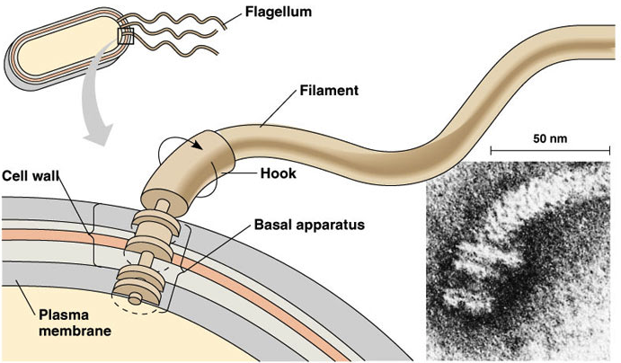
Cell surface components

Slide 54
Cell surface components
2) Fimbriae
Fimbriae are structurally similar to flagella, but are not involved in motility.
They are straighter, more numerous and considerably thinner and shorter (3 mm) than flagella.
They act primarily as adhesins, allowing organisms to attach to surfaces, including animal tissues in the case of some pathogenic bacteria, and to initiate biofilm formation.

Slide 55
Cell surface components
3) Pili
Pili are morphologically and chemically similar to fimbriae, but they are present in much smaller numbers (< 10) and are usually longer.
They are involved in the genetic exchange process of conjugation.

Slide 57
Cell surface components
4) Capsules and slime layers
Many bacteria secrete extracellular polysaccharides (EPS) that are associated with the exterior of the bacterial cell.
This layer provide a gummy exterior to the cell.
Morphologically, two extreme forms exist:
capsules, which form a tight, fairly rigid layer closely associated with the cell
slimes, which are loosely associated with the cell.

Slide 58
Cell surface components
Capsules and slime layers
Both forms function similarly:
to offer protection against desiccation
to provide a protective barrier against the penetration of biocides, disinfectants and positively charged antibiotics
to protect against engulfment by phagocytes.

Slide 59
Bacterial reproduction and growth

Slide 60
Bacterial reproduction and growth
The majority of bacterial cells multiply in number by a process of binary fission. That is, each individual will increase in size until it is large enough to divide into two identical daughter cells.
At the point of separation each daughter cell must be capable of growth and reproduction.
While each daughter cell will automatically contain those materials that are dispersed throughout the mother cell (mRNA, rRNA, ribosomes, enzymes, cytochromes, etc.)

Slide 61
Bacterial reproduction and growth
Bacteria has the ability to replicate rapidly when the conditions are favourable& optimal for growth.
For a microorganism growing with a generation time of 20 minutes, one cell will have divided three times within an hour to give a total of eight cells and so on.
Clearly this does not happen in nature, rather the supply of nutrients becomes exhausted and the organisms grow considerably more slowly, if at all.

Slide 62
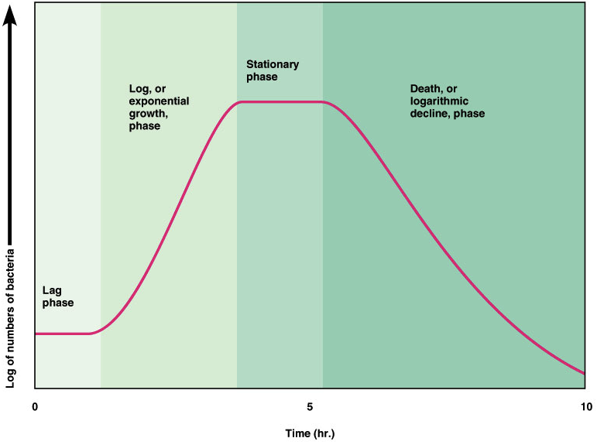
Growth curves
When a sample of living bacteria is inoculated into a medium adequate for growth, the change in viable population with time follows a characteristic pattern.

Slide 63
Growth curves
The first phase, A, is called the lag phase.
lag phase will be short if the culture medium is adequate (Nutrients & Optimal Temperature).
lag phase may be longer if the medium is minimal or has to warm up to the optimum growth temperature, and prolonged if toxic substances are present.

Slide 64
Growth curves
phase B which is called log phase
In this phase, the inoculum adaptes itself to the new environment and growth then proceeds, each cell dividing into two.
Cell division by binary fission may take place every 15-20 minutes
The increase in numbers is exponential or logarithmic, hence the name log phase.

Slide 65
Growth curves
Phase C, the stationary phase,
The stationary phase is thought to occur as a result of the exhaustion of essential nutrients and possibly the accumulation of bacteriostatic concentrations of wastes.
Growth will recommence if fresh medium is added to provide a new supply of nutrients and to dilute out toxic accumulations.

Slide 66
Growth curves
Phase D, the phase of decline
In the phase of decline, bacteria are actually dying due to the combined pressures of food exhaustion and toxic waste accumulation.

Slide 67
Growth curves

Slide 68
Bacterial reproduction and growth
The rate of growth of a microbial population depends upon:
Nature of microorganisms
Availability of water and nutrients
Temperature
pH
Partial pressure of oxygen
Solute concentrations.

Slide 69
Bacterial reproduction and growth
Temperature
The majority of bacteria that have medical or pharmaceutical significance have optimal growth temperatures between ambient and body temperature (37°C).
As temperatures rise, chemical and enzymic reactions within the cell proceed more rapidly, and growth becomes faster until an optimal rate is achieved.
Beyond optimal temperature certain proteins may become irreversibly damaged through thermal lysis, resulting in a rapid loss of cell viability.

Slide 70
Bacterial reproduction and growth
pH
Each individual microorganism has an optimal pH for growth.
Microorganisms that have medical or pharmaceutical significance have pH growth optima of between 7.4 and 7.6 but may grow suboptimally at pH values of 5–8.5.
The pH of a pharmaceutical preparation may dictate the range of microorganisms that could potentially cause its spoilage.

Slide 71
Bacterial reproduction and growth
Water activity/solutes
Bacteria requires a certain amount of water for their growth
The availability of water is expressed as water activity.
Water activity (Aw) is defined as the vapour pressure of water in the space above the material relative to the vapour pressure above pure water at the same temperature and pressure.
Pure water by definition has an Aw of 1.00.

Slide 72
Bacterial reproduction and growth
Water activity/solutes
Generally Gram- negative bacteria cannot grow if the Aw is below 0.97.
Gram-positive bacteria can grow in materials with Aw of 0.8–0.98.
Yeasts and moulds can grow at low Aw values.
Pharmaceutical creams might have Aw values of 0.8–0.98, whereas strawberry jam might have an Aw of c. 0.7.
The water activity of a pharmaceutical product can markedly affect its vulnerability to spoilage conta- minants

Slide 73
Bacterial reproduction and growth
Availability of oxygen
Some bacteria cannot grow unless oxygen is present in their immediate atmosphere, such organisms are called obligate aerobes.
Some organisms are inhibited in the presence of oxygen, this gas behaving almost as an intoxicant, such bacteria are known as obligate anaerobes.
A large number of species can grow in both in the presence and absence of oxygen and these are termed facultative bacteria.

Slide 74
Bacterial reproduction and growth
Nutrition
The essential food or nutritional requirements for bacterial growth conventionally include sugars, starches, proteins, vitamins, trace elements, oxygen, carbon dioxide and nitrogen.
Water is also of great importance; bacteria cannot grow without water and, water provides hydrogen as part of reaction sequences for the metabolism of the substrates.

Slide 76
Biofilms
4. Biofilms
Any surface, whether it is animate or inanimate, is of considerable importance as a microbial habitat owing to the adsorption of nutrients.
Microbial numbers and activity are usually much greater on a surface than in suspension.
In many natural, medical and industrial settings bacteria attach to surfaces and form multilayered communities called biofilms.

Slide 77
Biofilms
Biofilms commonly contain more than one species of bacteria, which cooperatively exist together as a functional, dynamic consortium.
Biofilm formation usually begins with pioneer cells attaching to a surface, either through the use of specific adhesins such as fimbriae, or non-specifically by EPS.
A key characteristic of biofilms is the enveloping of the attached cells in EPS.
Biofilms help trap nutrients for growth of the enclosed cells and help prevent detachment of cells on surfaces in flowing systems.

Slide 78
Biofilms
In the human body the resident cells within the biofilm are not exposed to attack by the immune system and in some instances can exacerbate the inflammatory response.
P. aeruginosa as an alginate-enclosed biofilm in the lungs of cystic fibrosis patients.
Bacterial biofilms are profoundly less susceptible to antimicrobial agents than their free-living, planktonic counterparts.

Slide 79
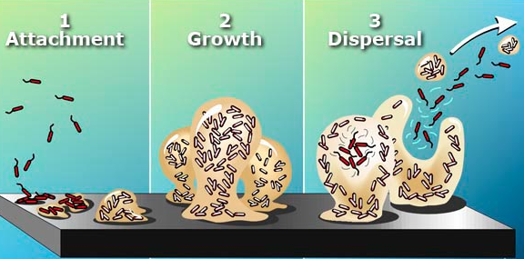
Biofilms
As a consequence, bacterial biofilms that form on contaminated medical implants and prosthetic devices, manufacturing surfaces are virtually difficult to eliminate with antibiotics or biocides.

Slide 81
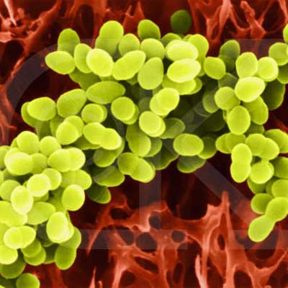
Properties of selected bacterial species
1. Gram-positive cocci:
Staphylococcus
They grow characteristically in aggregates which have been likened to a bunch of grapes.
They can grow aerobically or anaerobically.
Staphylococcus aureus produces a golden yellow pigment.
Staphylococcus aureus is a cause of skin lesions such as boils.
Staphylococcus aureus produces a toxin which, if ingested with food in which the organism has been growing, can give rise to food poisoning.
A common manifestation of its infection is the production of pus.

Slide 82
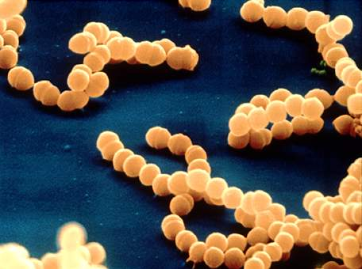
Properties of selected bacterial species
Streptococcus
These are spherical organisms which grow characteristically in chains like strings of beads
They can grow aerobically or anaerobically.
Streptococcus pyogenes is an extremely dangerous pathogen
Streptococcus pyogenes produces a series of toxins, including an erythrogenic toxin which induces a characteristic red rash, and a family of toxins which destroy the formed elements of blood.
Typical diseases caused by Strep. pyogenes are scarlet fever and acute tonsillitis (sore throat).

Slide 83
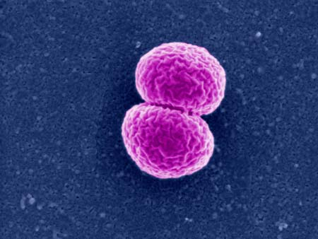
Properties of selected bacterial species
2. Gram-negative cocci:
Neisseria
The Gram-negative pathogenic cocci belong to the genus Neisseria.
The cells are slightly curved rather than true spheres and have been likened to a kidney bean in shape.
Neisseria gonorrhoeae is the causal organism of the venereal disease gonorrhoea (Sexually transmitted disease,STD).

Slide 84
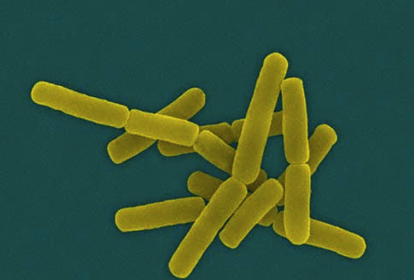
Properties of selected bacterial species
3. Gram-positive rods:
Bacillus
Members of this genus are widespread in air, soil and water, and in animal products such as hair, wool and carcasses.
It occurs characteristically as a large rod with square ends
It is aerobic.
Bacillus cereus has been implicated during recent years as a cause of food poisoning.

Slide 85
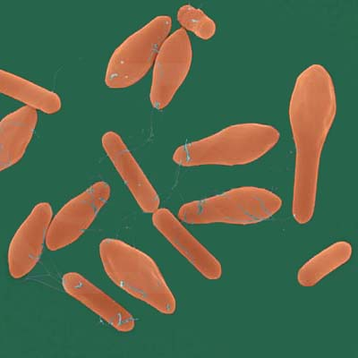
Properties of selected bacterial species
Clostridium
Clostridia are anaerobic rods.
The genus contains a number of dangerous pathogens.
Cl.septicum, CI. perfringens (welchii) and CI. novyi (oedematiens) cause serious damage to tissue if they are able to develop in wounds where the oxygen supply is limited.
Tissue may be destroyed, and carbon dioxide produced from muscle glycogen gives rise to the condition known as gas gangrene.

Slide 86
Properties of selected bacterial species
Clostridium
Clostridium botulinum (Sausages in Latin) secretes an extremely toxic nerve poison and ingestion of food in which this organism has grown is fatal.
Cooking rapidly destroys the poison but cold meats, sausages that contain the organism and that are eaten uncooked are possible sources of botulism.
Clostridium tetani produces a powerful central nervous system poison and gives rise to the condition known as lockjaw or tetanus (prolonged contraction of skeletal muscle fibers).

Slide 87
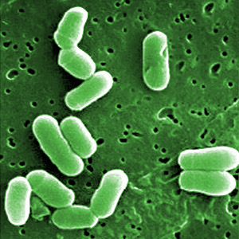
Properties of selected bacterial species
Corynebacterium
Corynebacterium diphtheriae, is the causal organism of diphtheria, a disease which has largely been eradicated by immunization (upper respiratory tract illness characterized by sore throat, fever).
Gardnerella vaginalis, although often part of the normal flora of the vagina, can be a cause of vaginitis. It has been suggested that the condition is expressed in association with anaerobes. It responds to treatment with metronidazole.

Slide 88
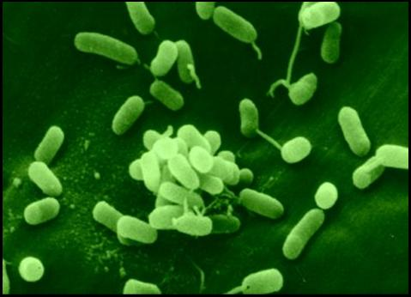
Properties of selected bacterial species
4. Gram-negative rods:
Pseudomonas
Pseudomonas aeruginosa has in recent years, assumed the role of a dangerous pathogen.
It has long been a troublesome cause of secondary infection of wounds, especially burns.
With the advent of immunosuppressive therapy following organ transplant, systemic infections including pneumonia have resulted from infection by this organism.
Pseudomonas aeruginosa is resistant to many antibacterial agents .

Slide 89
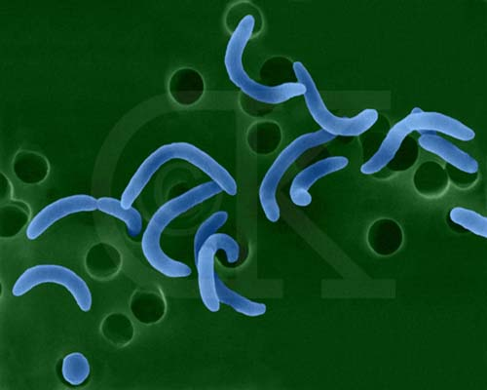
Properties of selected bacterial species
Vibrio
Vibrio cholerae {comma) is often seen in the form of a curved rod (or a comma), hence its alternative specific name.
It is the causal organism of Asiatic cholera.
Asiatic cholera is still endemic in India and Burma (main symptoms are profuse watery diarrhea,vomiting and abdominal pain).
It is a water-borne organism and infection may be prevented in epidemics by boiling all water and consuming only well-cooked foodstuffs.

Slide 90
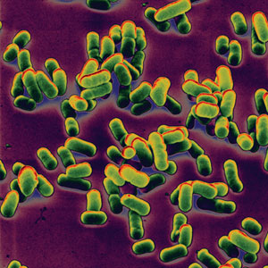
Properties of selected bacterial species
Yersinia
Yersinia pestis is the causal organism of plague or the Black Death which ravaged the Europe at various times.
It infects the lymphatic system to give bubonic plague, the more usual form, or the respiratory system, giving the rapidly fatal pneumonic plague.
Swollen lymph nodes (buboes) especially occur in the armpit and groin in persons suffering from bubonic plague.

Slide 91
Properties of selected bacterial species
Bordetella
Bordetellapertussis is the causal organism of whooping-cough (Pertussis), a disease has been largely eradicated by a successful immunization programme.
Haemophilus
Haemophilus influenzae owes its specific name to the fact that it was thought to be the causal organism of influenza (now known to be a virus disease) as it was often isolated in cases of influenza.
It is the main cause of infantile meningitis and conjunctivitis and is one of the most important causes of chronic bronchitis.

Slide 92
Properties of selected bacterial species
Escherichia
Escherichia are members of a group of microorganisms known as the enterobacteria, so called because they inhabit the intestines of humans and animals.
Escherichia coli is a cause of enteritis in young infants and the young of farm animals, where it can cause diarrhoea and fatal dehydration.

Slide 93
Properties of selected bacterial species
Salmonella
Salmonella typhi is the causal organism of typhoid fever
Sal. typhimurium, Sal. enteritidis and very many other closely related organisms are a cause of bacterial food poisoning.
Campylobacter
Campylobacters are thin, Gram-negative organisms which are in essence rod-shaped but often appear in culture with one or more spirals or as 'S' and 'W (gull-winged) shaped cells.
They move by means of a single polar flagellum.
They are unable to grow below 30°C.

Slide 94
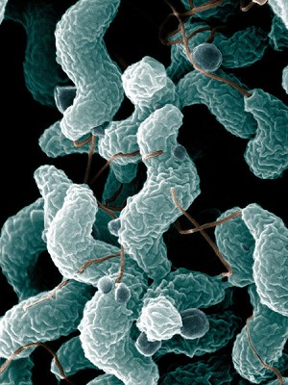
Properties of selected bacterial species
Campylobacter
Campylobacter jejuni has emerged during the last few years as a major cause of enteritis in humans and is mainly transmitted by contaminated food.
It is a food-poisoning microorganism.
Helicobacter
This genus, originally grouped with the Campylobacters, is now , is now considered a separate genus.
Helicobacter pylori is of interest as a cause of peptic ulcer.

Slide 95
Properties of selected bacterial species
5. Acid-fast organisms:
These comprise a group of organisms which, like the Gram-positive and Gram-negative groups, have been named after a staining reaction.
Due to a waxy component in the cell wall these organisms are difficult to stain with ordinary stain solutions, the hydrophobic nature of the wall being stain repellent.

Slide 96
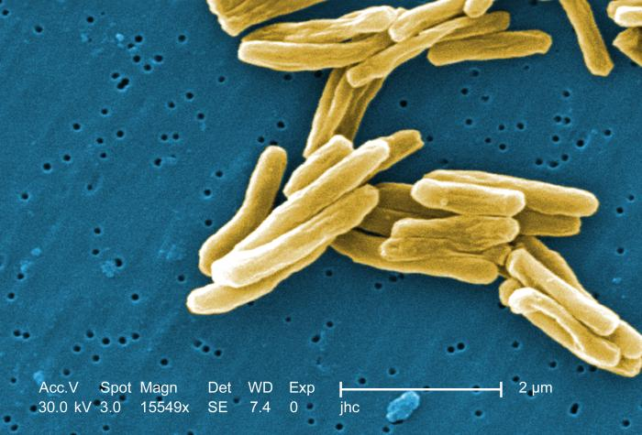
Properties of selected bacterial species
Mycobacterium
Mycobacterium tuberculosis is the causal organism of tuberculosis in humans (Symptoms include chest pain, coughing up blood, and a productive, prolonged cough for more than three weeks).
Allied strains cause infections in animals, e.g. bovine tuberculosis and tuberculosis in rodents.
Tuberculosis has been largely eliminated by immunization and chemotherapy.

Slide 97
Properties of selected bacterial species
6. Spirochaetes:
Spirochaetes have a unique shape, structure and mode of locomotion.
They are not stained easily by normal staining methods and thus cannot be designated either Gram- negative or Gram-positive.
They are slender rods in the form of spirals, like a corkscrew.

Slide 98
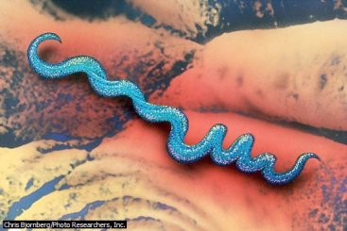
Properties of selected bacterial species
Treponema
Treponema pallidumis the causal organism of syphilis (Sexually transmitted disease).
Borrelia
Borrelia recurrentis causes a relapsing fever in humans.
Borrelia vincenti is the cause of Vincent's angina in humans, an ulcerative condition of the mouth and gums.
Borrelia burgdorferi is the causal organism of the tick-borne Lyme disease (Borrelia is transmitted to humans by the bite of infected ticks).

